Slide 1
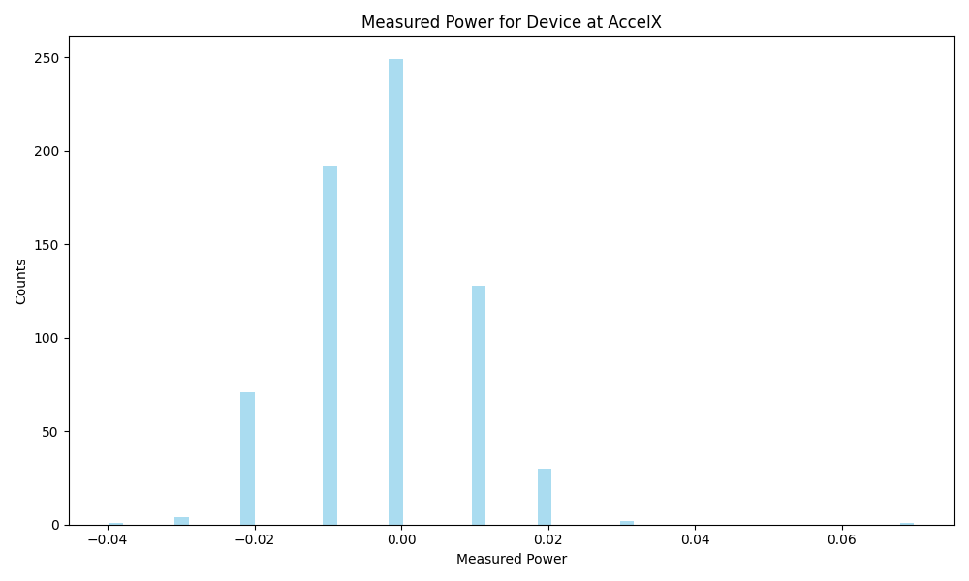
Frequency | Metric
Count | 678
Mean | -0.00
Std | 0.01
Min | -0.04
Max | 0.07

Slide 2
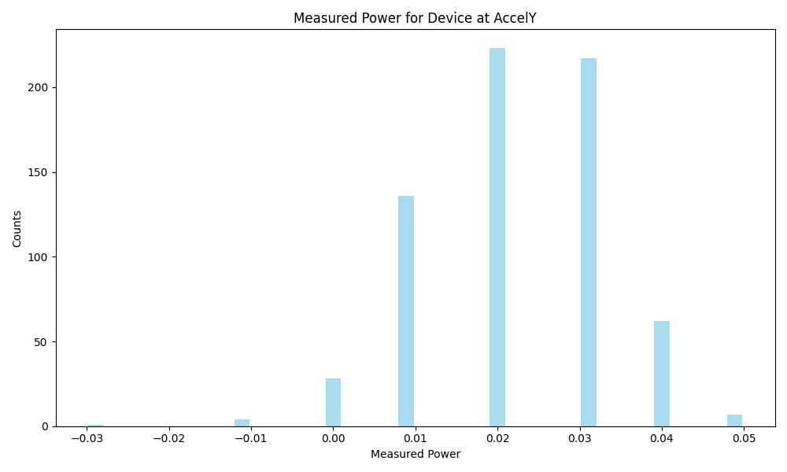
Frequency | Metric
Count | 678
Mean | 0.02
Std | 0.01
Min | -0.03
Max | 0.05

Slide 3
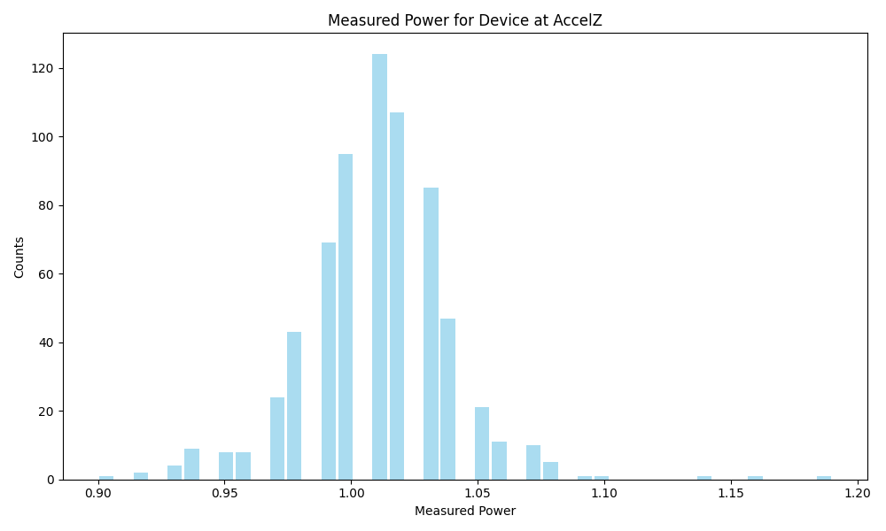
Frequency | Metric
Count | 678
Mean | 1.01
Std | 0.03
Min | 0.9
Max | 1.19

Slide 4
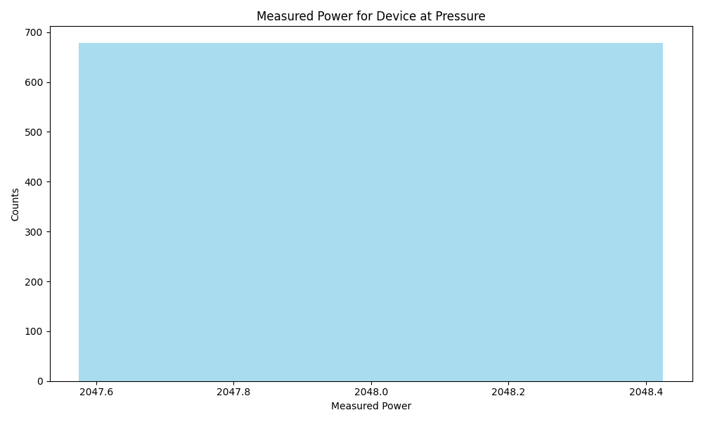
Frequency | Metric
Count | 678
Mean | 2048.00
Std | 0.00
Min | 2048.0
Max | 2048.0

Slide 5
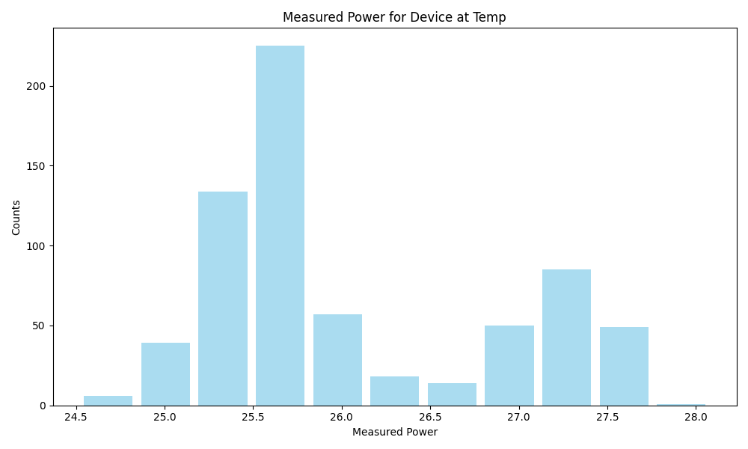
Frequency | Metric
Count | 678
Mean | 26.05
Std | 0.81
Min | 24.52
Max | 28.08

Slide 6
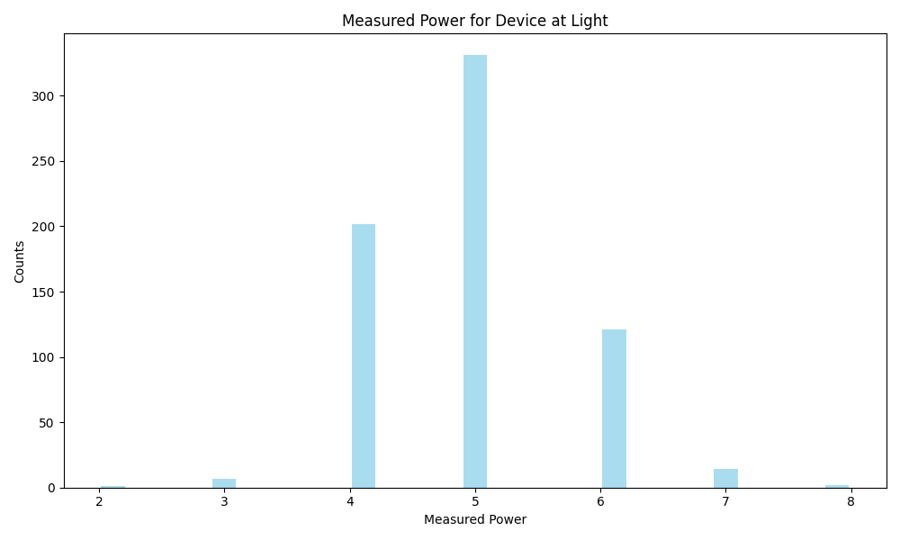
Frequency | Metric
Count | 678
Mean | 4.91
Std | 0.79
Min | 2.0
Max | 8.0

Slide 7
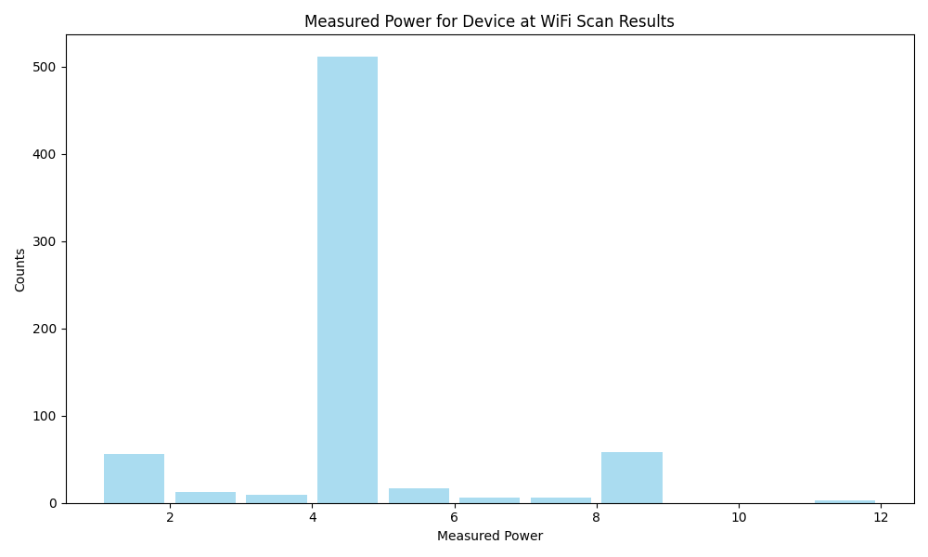
Frequency | Metric
Count | 678
Mean | 4.15
Std | 1.61
Min | 1
Max | 12

Slide 8
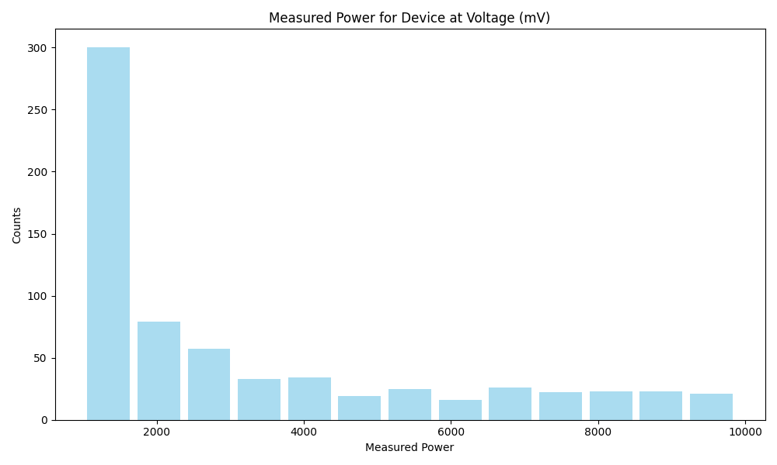
Frequency | Metric
Count | 678
Mean | 3292.71
Std | 2537.74
Min | 1002.885
Max | 9880.363

